Slide 1









My Algebra - Quadratics Interactive Notebook
$$×$$
$$\frac{1}{2}$$
$$÷$$
$$+$$
$$−$$
$$\frac{3}{5}$$
$$7$$
Name
Class
Teacher
Term 2 Semester 1
$$5^{2}$$
$$\sqrt{9}$$

Slide 2
Contents
Glossary or Formula Page
Page
Date
Description
2

Slide 3
Tasks
24
7
30
Essential Question
Questions
Notes
Summary
6

Slide 4
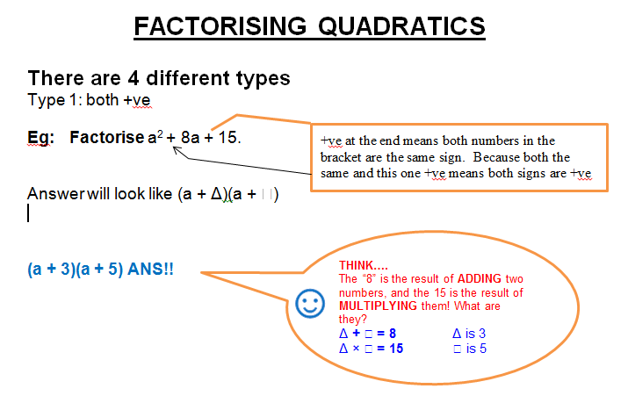
24
7
30
Date
Factorisation

Slide 5
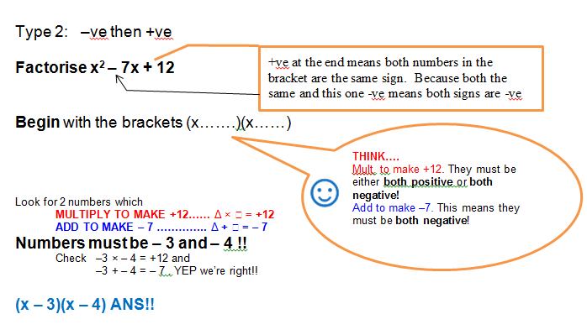
24
7
30
Date
Factorisation

Slide 6
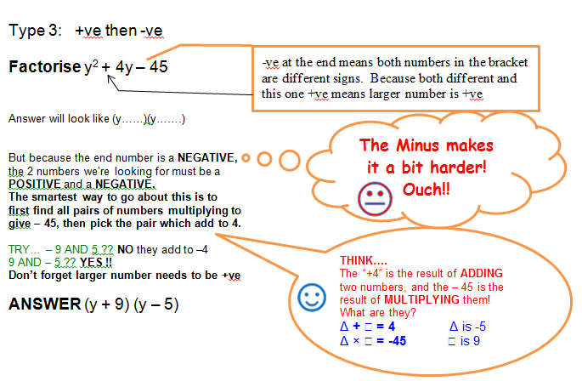
24
7
30
Date
Factorisation

Slide 7
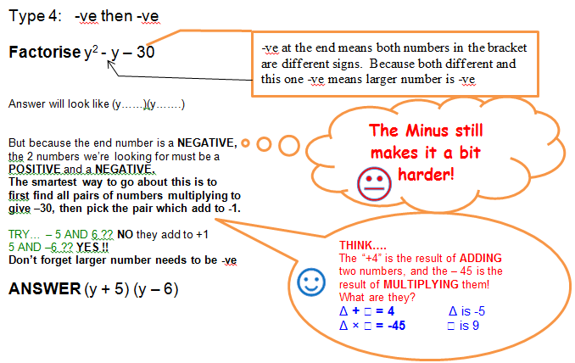
24
7
30
Date
Factorisation

Slide 8
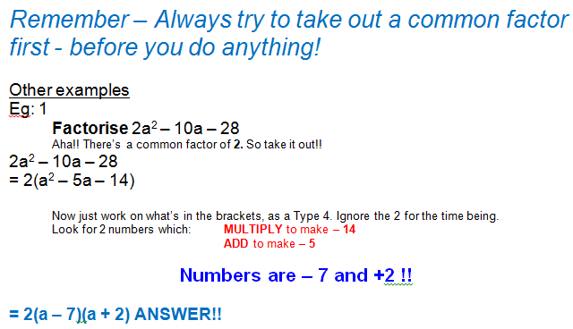
24
7
30
Date
Factorisation

Slide 9
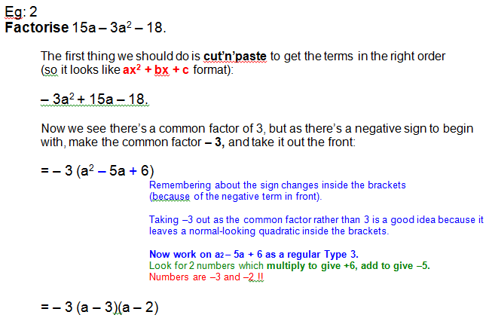
24
7
30
Date
Factorisation

Slide 10
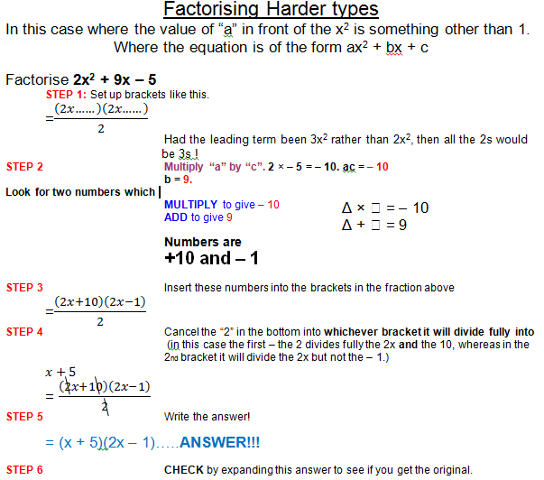
24
7
30
Date
Factorisation

Slide 11
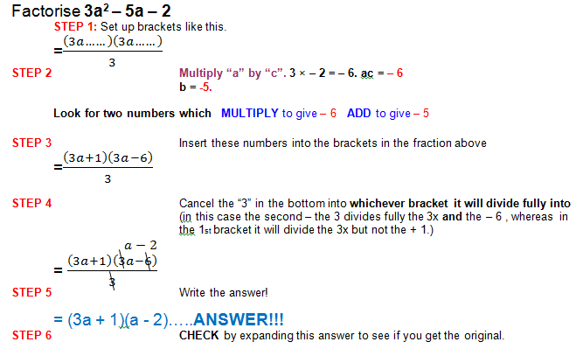
24
7
30
Date
Factorisation

Slide 12
Exercises
Exercise – handout sheet
plus
Exercise 6.4 and 6.9 from Dwyer
All to be done with a smile on your faces.

Slide 13
Notes Review
24, 7 ,30
Date
Title
Essential question
Notes complete
Notes complete with colour and diagrams
Questions completed
Contents page filed in
Formula page filled in

Slide 14
Homework
Review your notes and write a summary answering the essential question.

